Slide 1


Spain Electricity Shortfall Solution
EXPLORE
Data Science Academy
Notes:
To use this title animation slide with a new image simply 1) move the top semi-transparent shape to the side, 2) delete placeholder image, 3) click on the picture icon to add a new picture, 4) Move semi-transparent shape back to original position, 5) Update text on slide.

Slide 2
Introduction
Problem Statement
Data
OUTLINE
EDA
Feature Engineering
Modelling
Conclusion

Slide 3
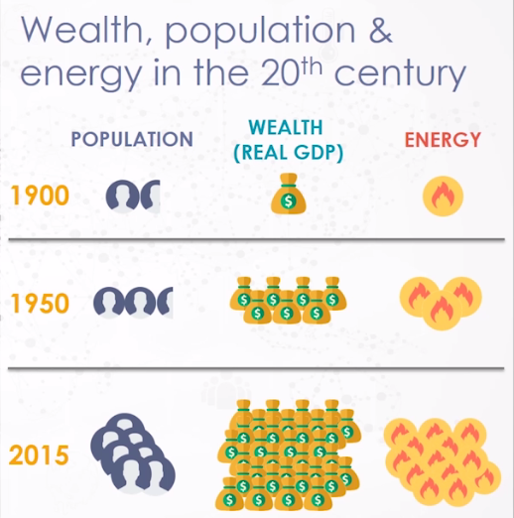


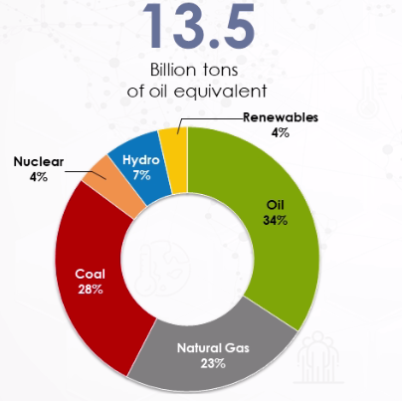

Introduction
Brief on Energy Crisis
The Challenge
Solution
Efficient Grid Management
Efficient Energy Storage

Slide 4
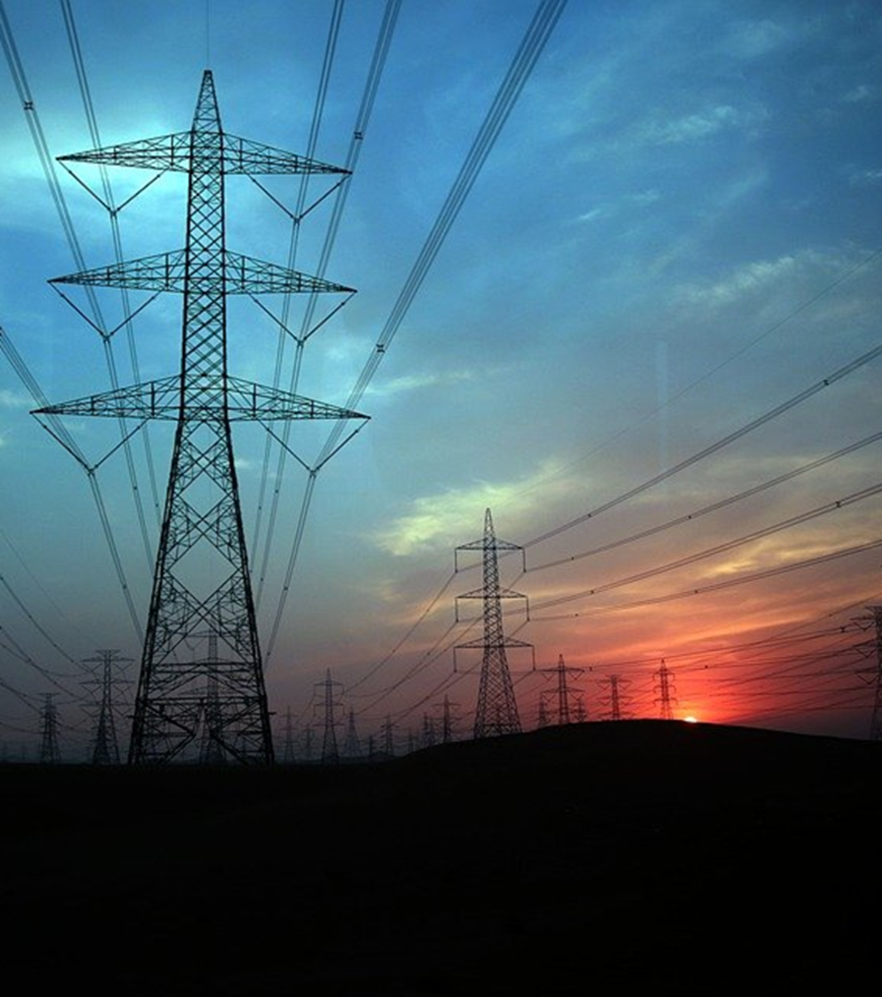
Problem Statement
Availability
Sustainability
Affordability
Reliability

Slide 5
Data
Available Resource
Made available are the Train Data and Test Data set for Madrid, Valencia, Seville, Bilbao, Barcelona.
Features from the dataset
Features: wind speed, wind deg., temperature etc.
Target from the dataset
load_shortfall_3h

Slide 6
Project life cycle
Model Deployment
Model tuning
Data collection preprocessing
Data Visualization
Feature Engineering
Model Training and Evaluation

Slide 7

Exploratory Data Analysis
Descriptive ANALYSIS
Detection and Treatment of MISSING DATA
Identification of ABNORMAL DATA
Adjustment of VARIABLE TYPES
Correlation of VARIABLES
Conclusion
Raw Data

Slide 8

Feature Engineering
Clean & Organizing Data
Mining Data for Patterns
Build Training Set

Slide 9
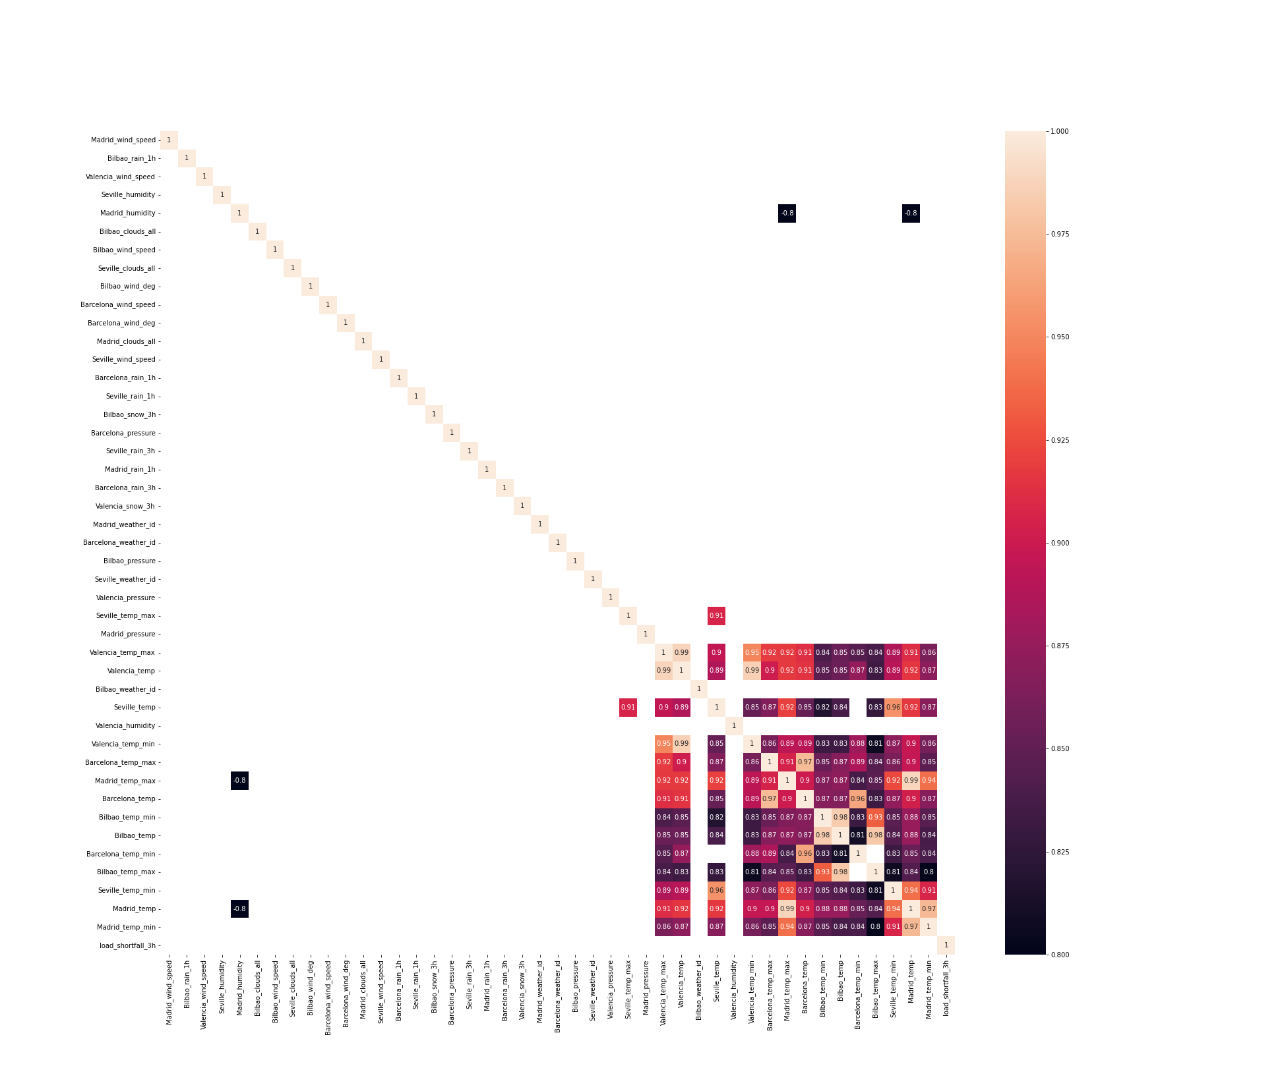
Correlation Heatmap
Weather Features vs Shortfall Correlation

Slide 10
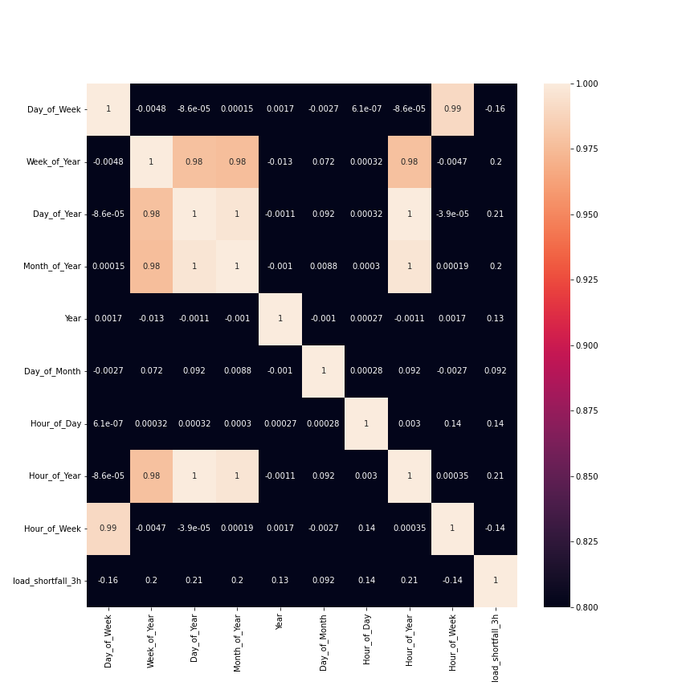
Correlation Heatmap
Time vs Shortfall Correlation

Slide 11

MODELLING
.
Linear Regression
.
Ridge Regression
.
Lasso Regression
.
XgBoost Regression

Slide 12
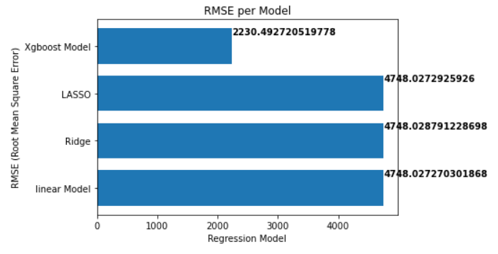
Performance Evaluation

Slide 13
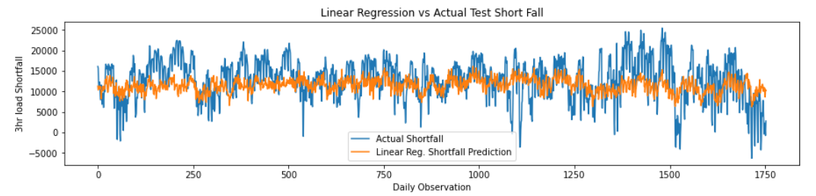
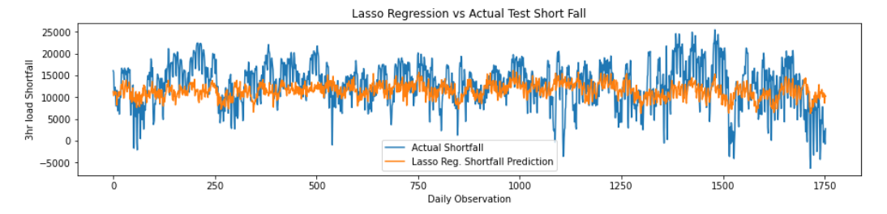
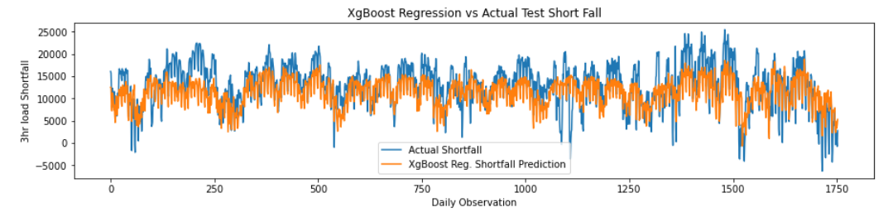
Conclusion
XgBoost Performance Best
Better on Unseen Data

Slide 14

Conclusion
Shortfall Prediction, Now a thing of the PAST

Slide 15


THANK YOU!

